Slide 1
UAVs for vaccines delivery
ITPA project
Ivan Riolo

Slide 2




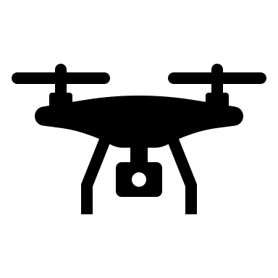


UAVs for vaccines delivery: motivation
Delivery in difficult to reach area, mainly rural context
The last part of distribution chain, poorly connected environments or red zone
UAVs as ‘quadcopters’ dornes, less expensive
Temperature and position monitoring and control

Slide 3
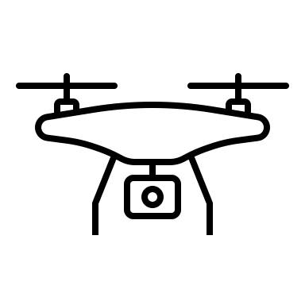
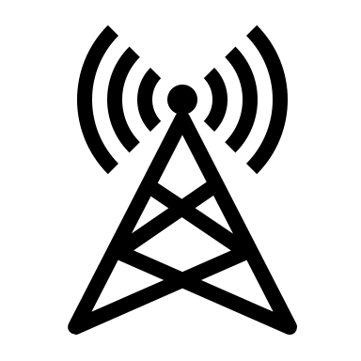




Framework
IoT sensors network for measurments and communications
Each drone is a source node of the sensors network
Thermal pack containing the vaccines:
Time limitation, need of an alarm when temperature cross a threshold
Contactless delivery in covid 19 emergency

Slide 4




Requirements: Power and Coverage
Battery based drones, low power consumptions is a must:
Bigger battery, more weight, more consumption
Long range communications:
UAVs has to communicate their data at distances of several kilometers to perform delivery in a wide area scenario
15 km

Slide 5



Requirements: Latency
Latency in normal situation (no alarm activated)
Semi real time acceptable (few seconds of delay)
Latency in critical situation (alarm activated)
Low latency is required (fraction of seconds delay)

Slide 6
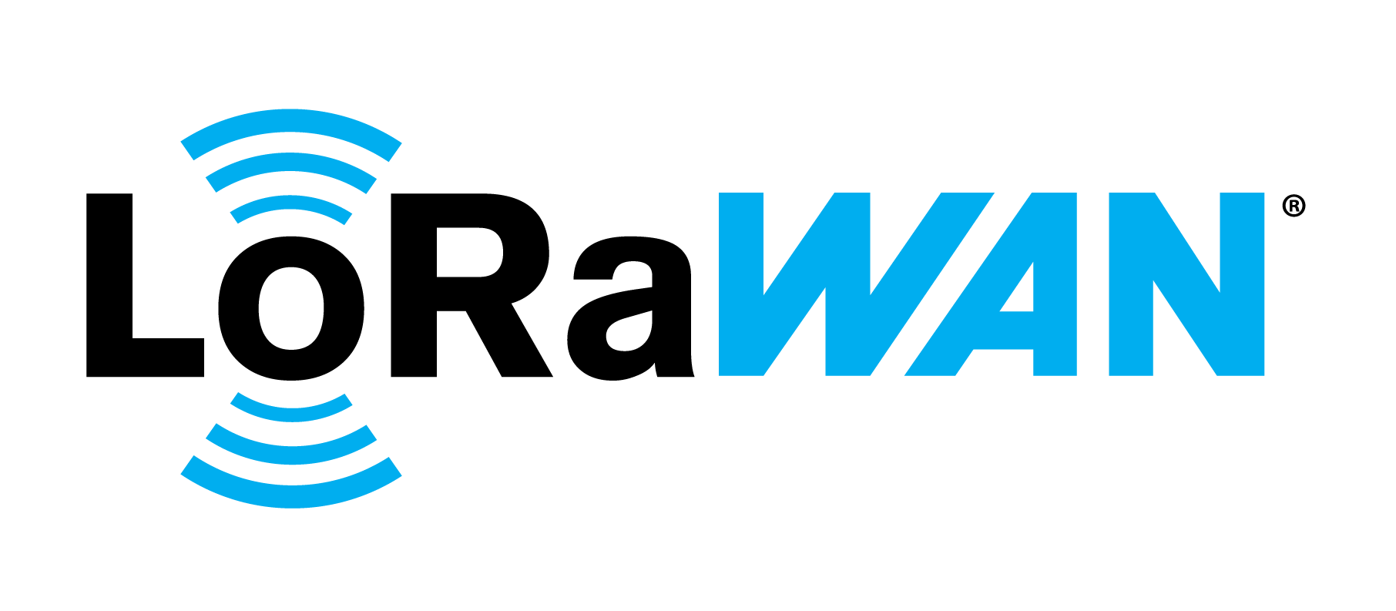
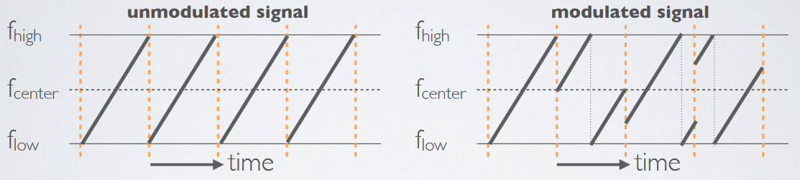
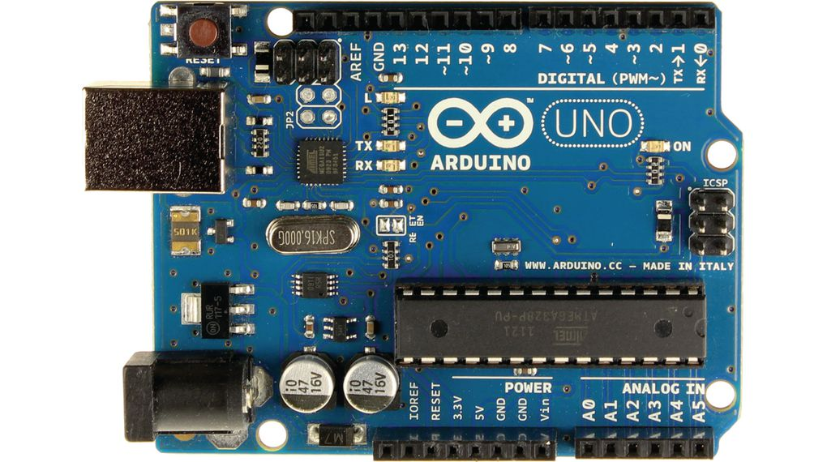
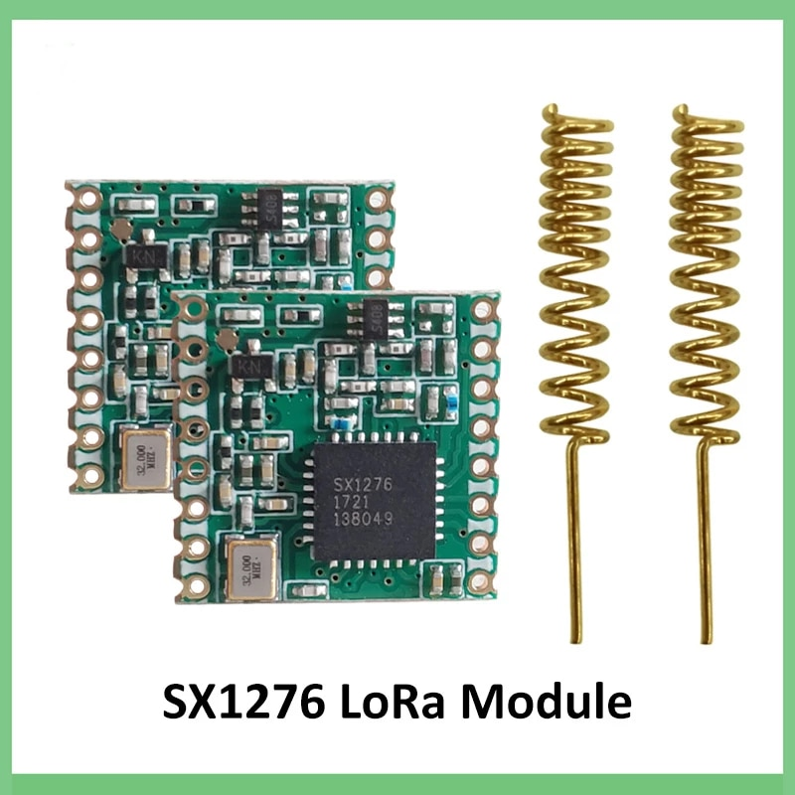
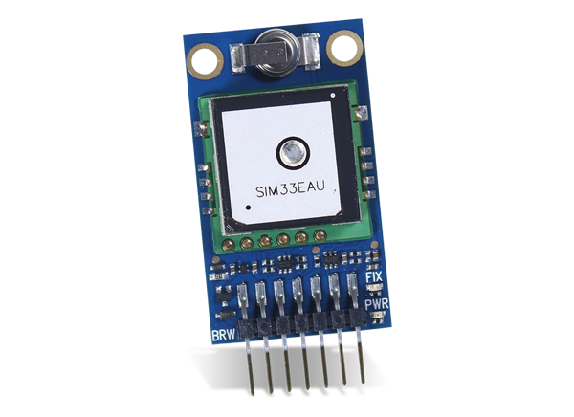
Proposed solution: LPWAN
Adaptive data rate,
CSS modulation
(Why?)
Motherboard on drones with LoRa Module and GPS module
Doppler frequency resistence
Extreme energy saving in mode A operations, no critical situations
Low latency and low energy in mode B operations for critial situations
Loss of primary signal
Temperature limit crossing

Slide 7

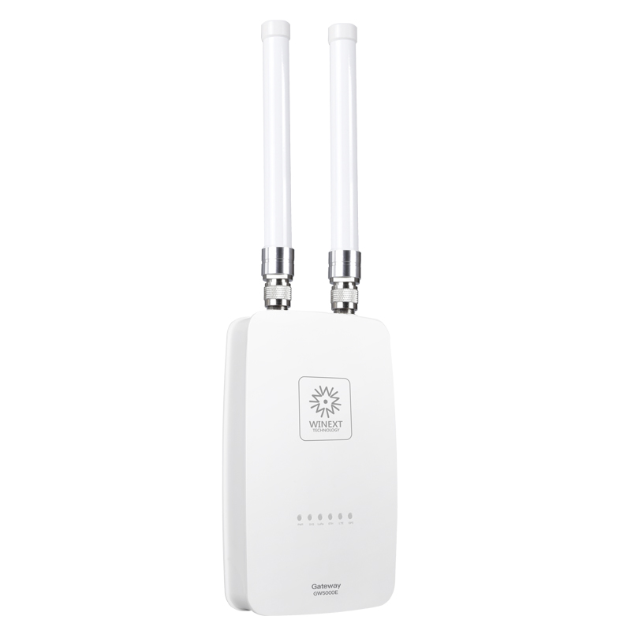
Proposed solution: Limitations
ISM duty cycle limitation: EU 1% per sub band
Split sub band in N channel: Duty cycle/N
Low data rate
GPS and temperature data: 12 Bytes application payload (Possibile to reduce with some techniques)
Isolated environment, difficult deployment
At least few cellular bs and power grid are present
Very small LoRa Gateway
Up to 8 channel: 0.899s Tx interval
and 72 ms Air Time
Latitude, Longitude, Heigth and Temperature

Slide 8
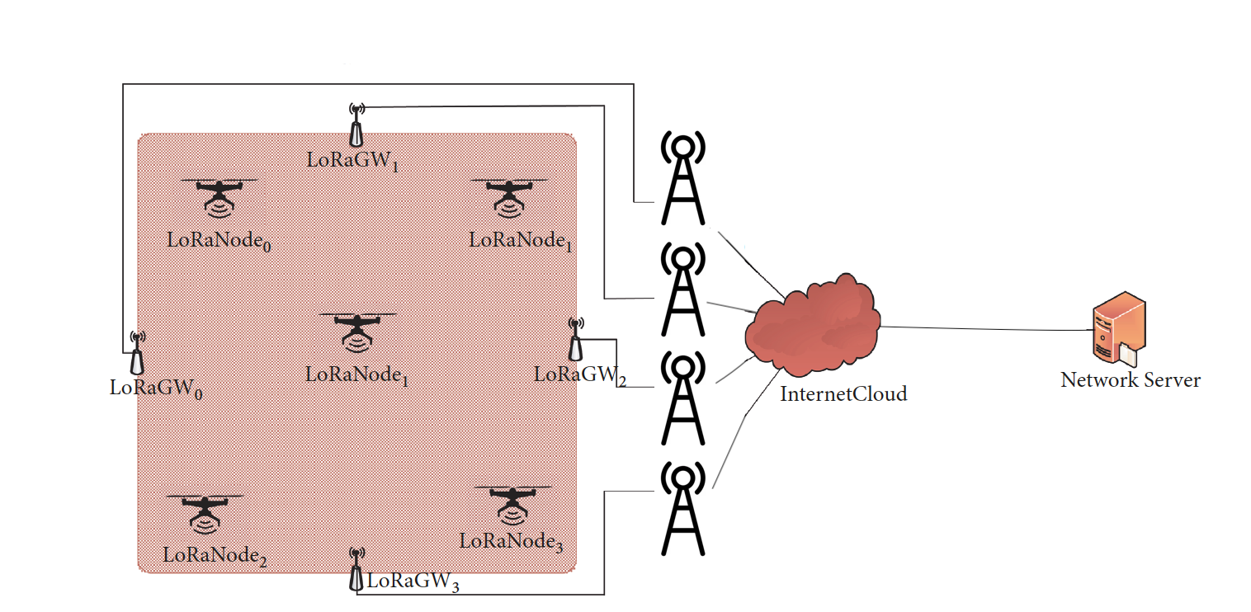
Architecture
Easy deployment of LoRa GW
(considering the environment)
Also 3G BS offers enough data rate to the application traffic (very small packets)
3G/4G BS
Uasually not full cellular coverage in these areas:
LoRa GW ‘extend’ coverage
NB-IoT and 3GPP solution is not suitable in this case
GW-InternetCloud Link:
Solution strictly depend from environment

Slide 9
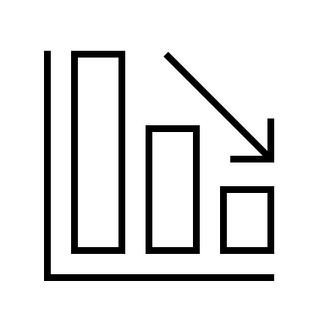





Comparison: Why LoRa?
SigFox: very low thorughput
Ingegnu: RPMA same frequency of primary control drone (2.4GHz)
Also if we think to extend this application to an urban area, very interferred spectrum (WiFi,Bluethoot)
No adaptive SF built in
3GPPP solutions: not guarantee a full coverage of rural areas
Best solution in this scenario: LoRa Chirped Spread Spectrum modulation + adaptive SF
A and B mode of operations, extremly adaptive to every situations

Slide 10

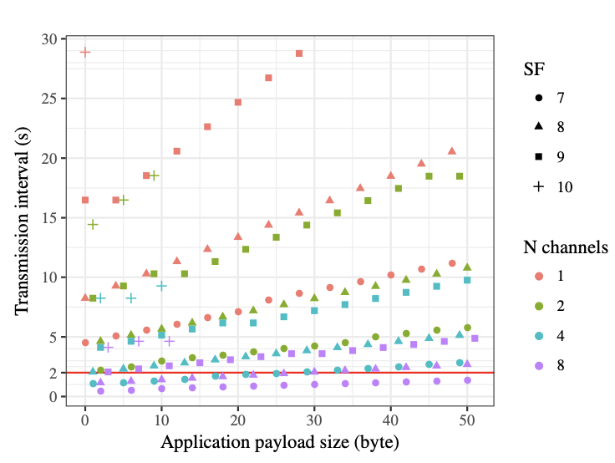
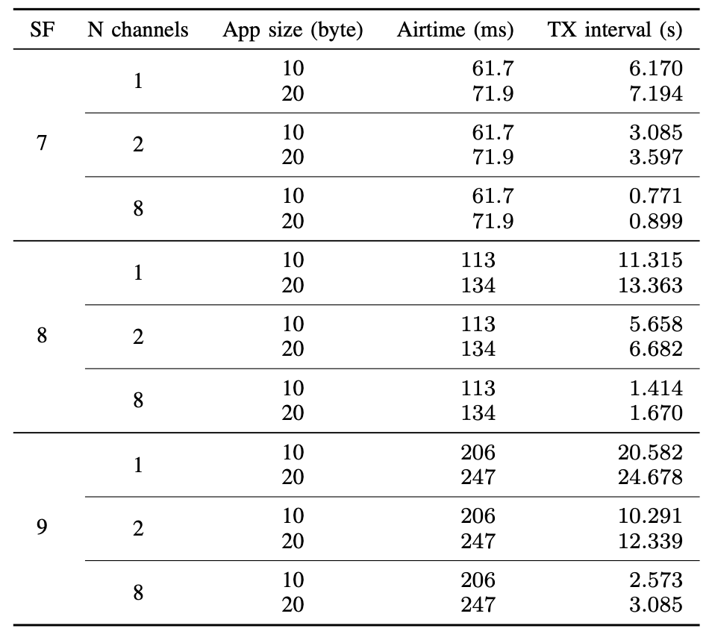

Result
Respecting the duty cycle + 400ms dwell time limit
SFs 7,8,9 with 8 channels is the best choice
Time on Air VS App. payload

Slide 11
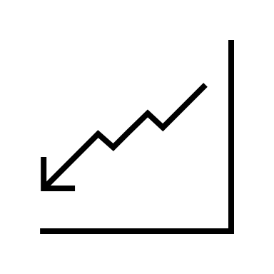
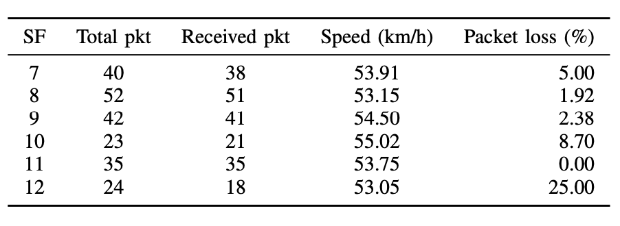
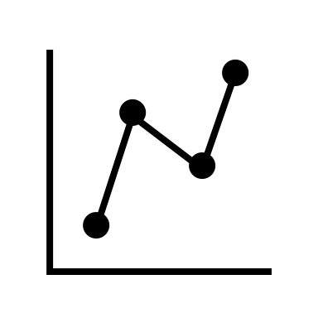

Result: Pakets loss
0.5
Evaluetion of QoS in term of packet loss in mobility scenario
Usually, higher SF, higher ToA, higher probability of collision
Evaluation performed in an urban area
Rural area implementation will theoretically perform better

Slide 12
References
A. Rahmadhani, Richard, R. Isswandhana, A. Giovani and R. A. Syah, "LoRaWAN as Secondary Telemetry Communication System for Drone Delivery," 2018 IEEE International Conference on Internet of Things and Intelligence System (IOTAIS), 2018, pp. 116-122, doi: 10.1109/IOTAIS.2018.8600892.
U. Raza, P. Kulkarni and M. Sooriyabandara, "Low Power Wide Area Networks: An Overview," in IEEE Communications Surveys & Tutorials, vol. 19, no. 2, pp. 855-873, Secondquarter 2017, doi: 10.1109/COMST.2017.2652320.
J.-M. Martinez-Caro, M.-D. Cano, "IoT System Integrating Unmanned Aerial Vehicles and LoRa Technology: A Performance Evaluation Study", Wireless Communications and Mobile Computing, vol. 2019, Article ID 4307925, 12 pages, 2019.https://doi.org/10.1155/2019/4307925J.
Penã Queralta, T.N. Gia, Z. Zou, H. Tenhunen, T. Westerlund, Comparative Study of LPWAN Technologies on Unlicensed Bands for M2M Communication in the IoT: beyond LoRa and LoRaWAN, Procedia Computer Science, Volume 155, 2019, Pages 343-350, https://doi.org/10.1016/j.procs.2019.08.049.

